Slide 1
Report PEARSON IKOI
Marta Kołodziej

Slide 2
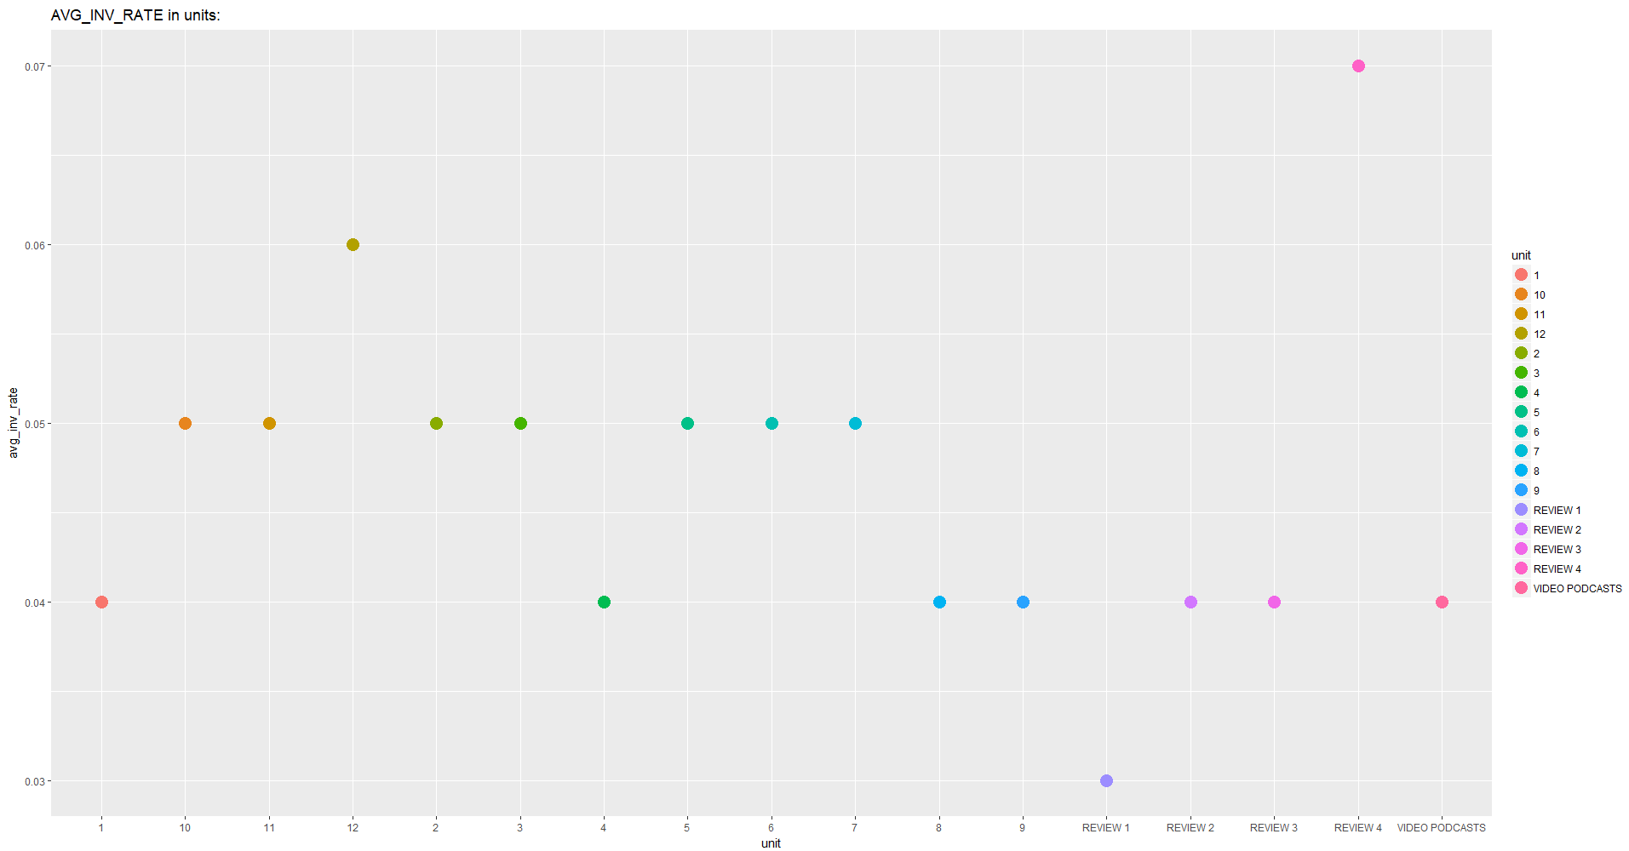

Slide 3
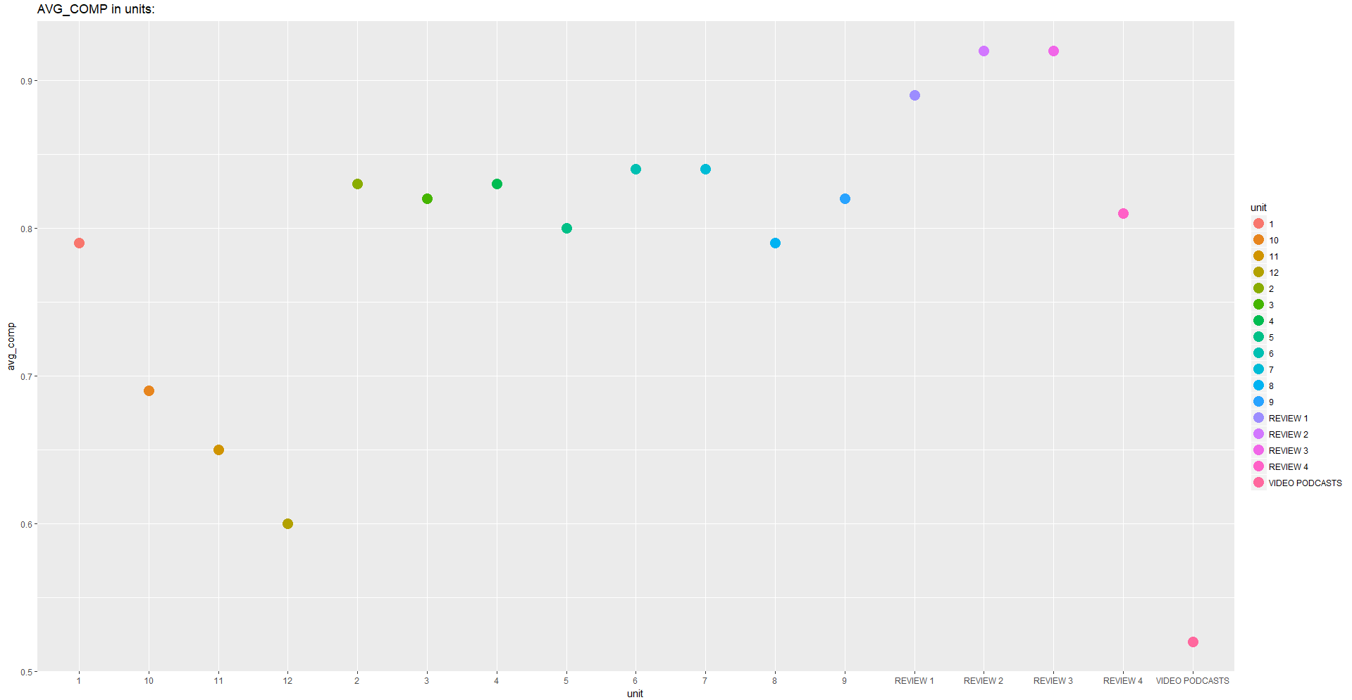

Slide 4
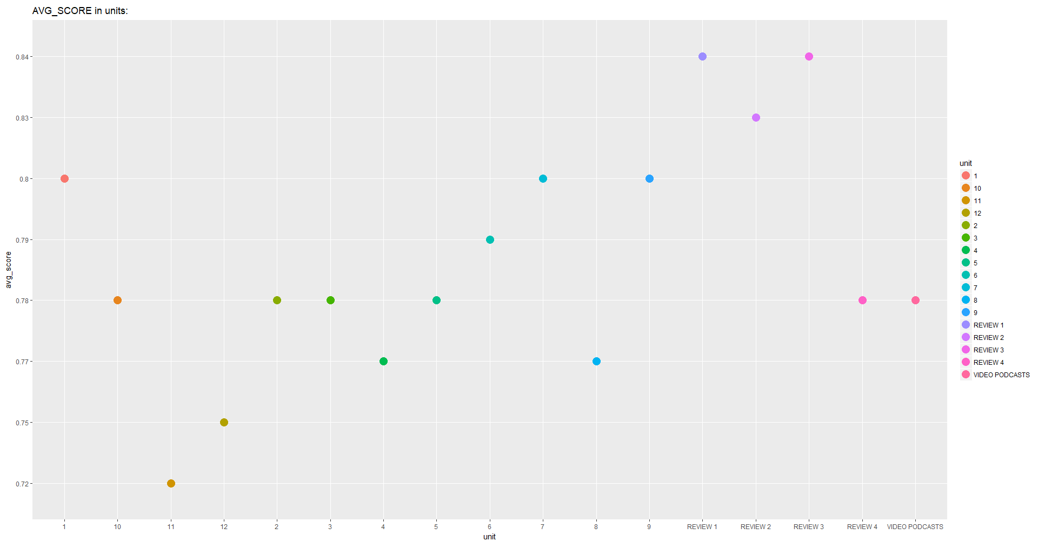

Slide 5
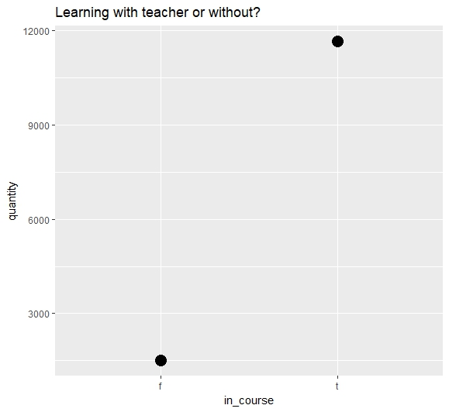

Slide 6
Test chi^2
IN_COURSE - COUNTRY
Pearson's Chi-squared test data:
X-squared = 592.32, df = 86, p-value < 2.2e-16
We reject a null hypothesis.

Slide 7
InFluence IN_course
 | in_course | avg_course
1 | f | 0.75
2 | t | 0.8
 | in_course | quantity
1 | f | 1514
2 | t | 11655

Slide 8
Rates in units – order by quantity
 | unit | quantity | avg_score | avg_inv_rate | avg_comp
1 | 1 | 11403 | 0.8 | 0.04 | 0.79
2 | 2 | 9242 | 0.78 | 0.05 | 0.83
3 | 3 | 8159 | 0.78 | 0.05 | 0.82
4 | 4 | 7153 | 0.77 | 0.04 | 0.83
5 | 5 | 6447 | 0.78 | 0.05 | 0.80
6 | 6 | 5912 | 0.79 | 0.05 | 0.84
7 | REVIEW 1 | 5400 | 0.84 | 0.03 | 0.89
8 | 7 | 5295 | 0.8 | 0.05 | 0.84
9 | 8 | 4830 | 0.77 | 0.04 | 0.79
10 | REVIEW 2 | 3824 | 0.83 | 0.04 | 0.92
11 | 9 | 3608 | 0.8 | 0.04 | 0.82
12 | VIDEO PODCASTS | 3364 | 0.78 | 0.04 | 0.52
13 | REVIEW 3 | 2383 | 0.84 | 0.04 | 0.92
14 | 10 | 1757 | 0.78 | 0.05 | 0.69
15 | 11 | 1195 | 0.72 | 0.05 | 0.65
16 | 12 | 938 | 0.75 | 0.06 | 0.60
17 | REVIEW 4 | 483 | 0.78 | 0.07 | 0.81

Slide 9
Learners in COuntries
 | quantity | country
1 | 6661 | TR
2 | 1640 | ES
3 | 1391 | CO
4 | 1262 | PL
5 | 325 | OM
6 | 273 | NL
7 | 252 | IT
8 | 208 | CH
9 | 131 | CZ
10 | 125 | AU
11 | 106 | MX
12 | 97 | RU
13 | 58 | CN
14 | 41 | UA
15 | 38 | QU
16 | 37 | BE
17 | 34 | BY
18 | 33 | HU
19 | 28 | TL
21 | 25 | US
22 | 24 | NZ
23 | 22 | GB
24 | 21 | FR
25 | 20 | AR
26 | 20 | SA
27 | 18 | DE
28 | 17 | AD
29 | 14 | JP
30 | 12 | AQ
31 | 12 | KR
32 | 12 | TH
33 | 11 | ID
34 | 10 | EC
35 | 10 | LT
36 | 8 | AF
37 | 8 | BR
38 | 8 | LV
39 | 8 | SK
40 | 7 | AS
41 | >6 | OTHER

Slide 10
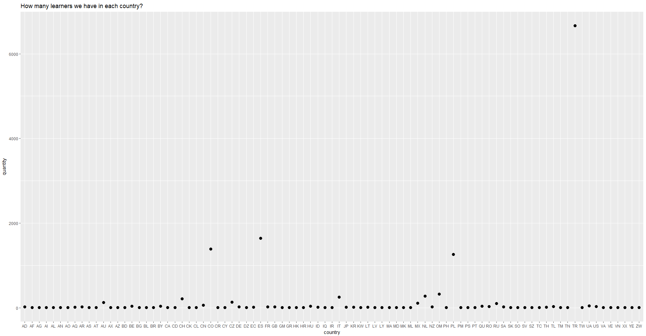

Slide 11
Rates in countries (quantity od units)
 | country | quantity | avg_score | avg_inv_rate | avg_comp
1 | TR | 52698 | 0.8 | 0.04 | 0.87
2 | ES | 8409 | 0.82 | 0.04 | 0.81
3 | PL | 5943 | 0.79 | 0.06 | 0.81
4 | CO | 5537 | 0.73 | 0.06 | 0.59
5 | IT | 1779 | 0.83 | 0.05 | 0.70
6 | OM | 856 | 0.66 | 0.09 | 0.26
7 | NL | 831 | 0.71 | 0.05 | 0.71
8 | CH | 554 | 0.77 | 0.05 | 0.31
9 | MX | 517 | 0.73 | 0.06 | 0.78
10 | CZ | 464 | 0.78 | 0.07 | 0.57
11 | AU | 432 | 0.71 | 0.05 | 0.64
12 | RU | 276 | 0.79 | 0.07 | 0.63
13 | TL | 260 | 0.72 | 0.05 | 0.48
14 | CN | 233 | 0.72 | 0.05 | 0.53
15 | RO | 218 | 0.79 | 0.05 | 0.56
16 | BE | 180 | 0.83 | 0.02 | 0.72
17 | HU | 167 | 0.77 | 0.03 | 0.75
18 | UA | 159 | 0.85 | 0.03 | 0.78
19 | QU | 134 | 0.77 | 0.05 | 0.77
20 | BY | 121 | 0.79 | 0.11 | 0.61
21 | SA | 111 | 0.7 | 0.07 | 0.36
22 | GB | 96 | 0.56 | 0.10 | 0.67
23 | NZ | 94 | 0.83 | 0.02 | 0.64
24 | US | 94 | 0.73 | 0.05 | 0.69
25 | AR | 89 | 0.85 | 0.07 | 0.72
26 | AD | 83 | 0.79 | 0.08 | 0.74
27 | FR | 78 | 0.81 | 0.05 | 0.75
28 | JP | 73 | 0.79 | 0.07 | 0.74
29 | LT | 68 | 0.59 | 0.10 | 0.77
30 | KR | 58 | 0.82 | 0.02 | 0.63
31 | TM | 48 | 0.86 | 0.08 | 0.88
32 | BG | 46 | 0.8 | 0.12 | 0.65
33 | AQ | 42 | 0.69 | 0.05 | 0.72
34 | DE | 37 | 0.69 | 0.08 | 0.38
35 | AZ | 35 | 0.82 | 0.08 | 0.80
36 | EC | 29 | 0.75 | 0.09 | 0.52
37 | TH | 29 | 0.86 | 0.03 | 0.61
38 | AS | 26 | 0.57 | 0.05 | 0.68
39 | YE | 26 | 0.59 | 0.07 | 0.33
40 | AF | 24 | 0.59 | 0.04 | 0.63

Slide 12
41 | BR | 24 | 0.77 | 0.06 | 0.66
42 | GR | 23 | 0.8 | 0.06 | 0.74
43 | ID | 23 | 0.88 | 0.08 | 0.54
44 | SO | 18 | 0.77 | 0.08 | 0.93
45 | AL | 17 | 0.79 | 0.04 | 0.69
46 | CY | 17 | 0.65 | 0.16 | 0.64
47 | SK | 17 | 0.87 | 0.11 | 0.52
48 | PS | 16 | 0.77 | 0.00 | 0.98
49 | TN | 16 | 0.82 | 0.01 | 0.56
50 | AX | 14 | 0.71 | 0.11 | 0.67
51 | KW | 14 | 0.61 | 0.04 | 0.35
52 | MD | 13 | 0.77 | 0.01 | 0.96
53 | MK | 13 | 0.88 | 0.00 | 0.97
54 | TC | 13 | 0.88 | 0.03 | 0.75
55 | CR | 12 | 0.6 | 0.06 | 0.70
56 | TW | 12 | 0.78 | 0.02 | 0.38
57 | VN | 12 | 0.89 | 0.01 | 0.39
58 | AG | 11 | 0.72 | 0.02 | 0.73
59 | LV | 11 | 0.84 | 0.04 | 0.29
60 | BL | 10 | 0.74 | 0.01 | 0.82
61 | HR | 10 | 0.77 | 0.05 | 0.28
62 | MA | 10 | 0.74 | 0.02 | 0.61
63 | VE | 10 | 0.78 | 0.00 | 0.54
64 | VA | 9 | 0.76 | 0.26 | 0.15
65 | XX | 9 | 0.72 | 0.09 | 0.92
66 | CL | 8 | 0.71 | 0.04 | 0.49
67 | CD | 7 | 0.94 | 0.00 | 0.97
68 | GM | 6 | 0.71 | 0.28 | 0.13
69 | ML | 6 | 0.78 | 0.01 | 0.47
70 | AI | 5 | 0.66 | 0.02 | 0.49
71 | DZ | 5 | 0.75 | 0.04 | 0.52
72 | HK | 5 | 0.65 | 0.00 | 0.20
73 | LY | 5 | 0.55 | 0.00 | 0.14
74 | AN | 4 | 0.89 | 0.03 | 0.51
75 | AO | 4 | 0.82 | 0.00 | 0.56
76 | IQ | 4 | 0.81 | 0.05 | 0.68
77 | PH | 4 | 0.62 | 0.00 | 0.78
78 | CK | 3 | 0.69 | 0.22 | 0.32
79 | IR | 3 | 0.75 | 0.00 | 0.11
80 | SV | 3 | 0.86 | 0.00 | 0.14
81 | SZ | 3 | 0.79 | 0.02 | 0.29
82 | AT | 2 | 0.79 | 0.04 | 0.59
83 | CA | 2 | 0.94 | 0.00 | 0.09
84 | PM | 2 | 0.78 | 0.00 | 1.00
85 | BD | 1 | 1 | 0.00 | 0.15
86 | PT | 1 | 0.97 | 0.00 | 0.15
87 | ZW | 1 | 1 | 0.00 | 0.10

